Slide 1
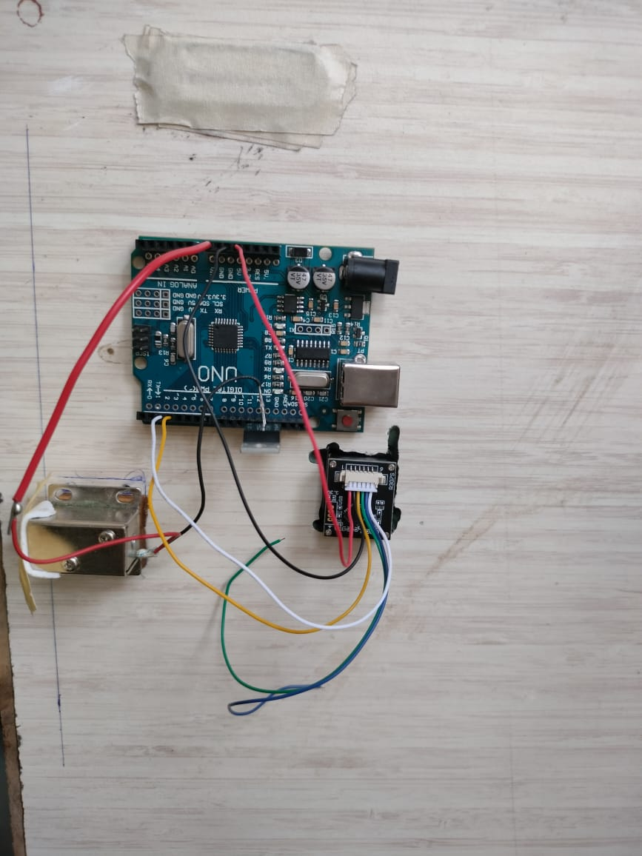
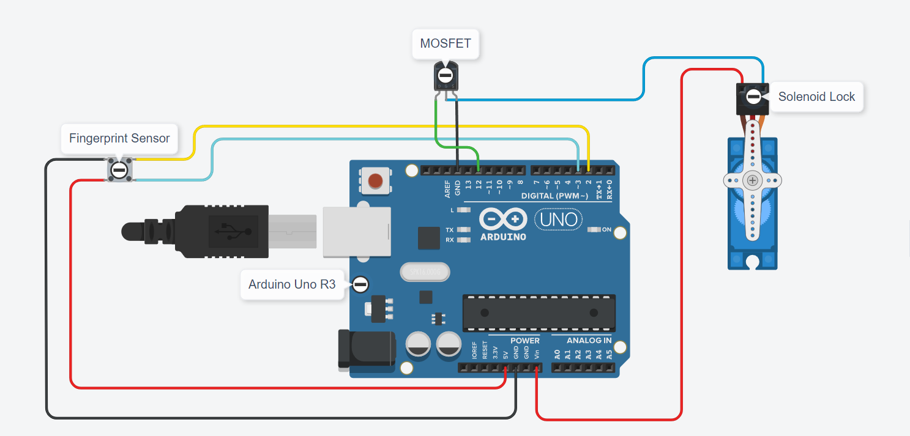
Fingerprint Locker -Advanced Biometric Security
Introduction:
This project uses a fingerprint sensor and a microcontroller to authenticate users. When a registered fingerprint is scanned, the locker unlocks; otherwise, access is denied. This method enhances security because fingerprints are unique and difficult to replicate.
Applications:
Home Security: Protects valuables at home.
Office Use: Secures important documents and items.
Educational Institutions: Safeguards personal belongings of students and staff.
Gyms and Clubs: Provides secure storage for members.
Hardware Simulation
Components:
RFZ44N Power MOSFET
Fingerprint Sensor
Solenoid Lock
Arduino Uno R3
Wooden Box
Circuit Diagram
Conclusion:
The IoT-based fingerprint locker system offers enhanced security and convenience by combining biometric authentication with remote access capabilities. By leveraging modern technology..
Objectives
To create a secure access control system
To utilize biometric technology for user authentication
Mayuri Yadav (41)
Sanika Landge (42)
Vaishnavi Patil(51)

